Slide 1
DATA STRUCTURES & ALGORITHMS WITH JAVA
Lesson 03: String Searching Improvement

Slide 2
Lesson Objectives
▪ Text Searching Introduction ▪ Different ways for text searching ✓Simple text searching ✓Rabin-Karp Algorithm ✓Knuth-Morris-Pratt (KMP) Algorithm ✓Boyer-Moore Algorithm ▪ Best practices for string searching

Slide 3

Discussion
1. Different ways to perform string search operations? 2. Ways to compare string? 3. Common string search methods? 4. Text searching approach 5. List some of the text searching applications.

Slide 4
Introduction to String
A string is actually an array of unicode characters. You can perform almost all the operations we used in an array.
Compare function
Can we use "==" to compare two strings?
Notes:
However, there are some differences. In this article, we will go through some of them which you should be aware of when dealing with a string
You should be aware of the time complexity of these built-in operations.
For instance, if the length of the string is N, the time complexity of both finding operation and substring operation is O(N).
Also, in languages which the string is immutable, you should be careful with the concatenation operation (we will explain this in next article as well).
Never forget to take the time complexity of built-in operations into consideration when you compute the time complexity for your solution.

Slide 5
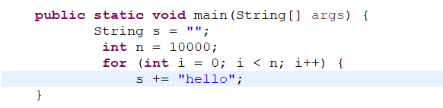
Immutable String
Beware of String Concatenation in Java

Slide 6
Immutable String - Problems
In Java, since the string is immutable, concatenation works by first allocating enough space for the new string, copy the contents from the old string and append to the new string.
Therefore, the time complexity in total will be:
5 + 5 × 2 + 5 × 3 + … + 5 × n
= 5 × (1 + 2 + 3 + … + n)
= 5 × n × (n + 1) / 2,
which is O(n2).

Slide 7
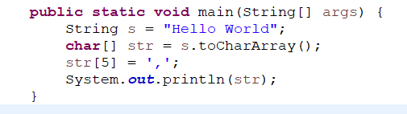
Immutable String - Solution
Use string as mutable
Convert it to a char array.

Slide 8
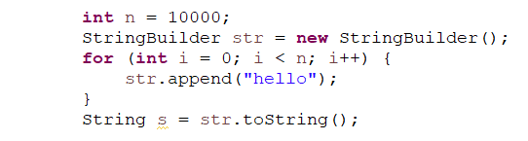
Immutable String - StringBuilder
If you have to concatenate strings often, it will be better to use some other data structures like StringBuilder. Code runs in O(n) complexity.

Slide 9
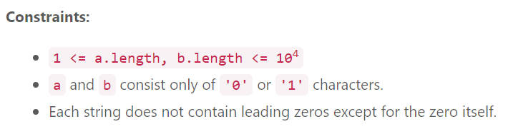
Add Binary
Given two binary strings a and b, return their sum as a binary string.
Example 1:
Input: a = "11", b = "1"
Output: "100“
Example 2:
Input: a = "1010", b = "1011"
Output: "10101"

Slide 10
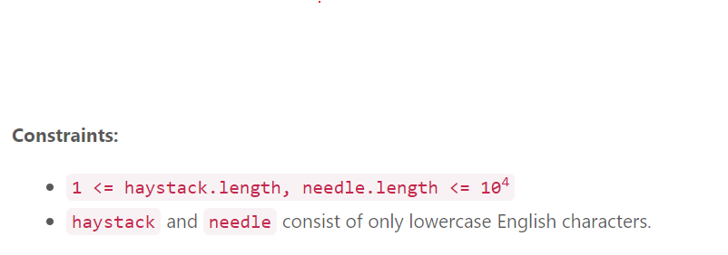
Implement strStr()
Given two strings needle and haystack, return the index of the first occurrence of needle in haystack, or -1 if needle is not part of haystack.

Slide 11
Implement strStr()
Example 1:
Input: haystack = "sadbutsad", needle = "sad"
Output: 0
Explanation: "sad" occurs at index 0 and 6.
The first occurrence is at index 0, so we return 0.
Example 2:
Input: haystack = "leetcode", needle = "leeto"
Output: -1
Explanation: "leeto" did not occur in "leetcode", so we return -1.

Slide 12
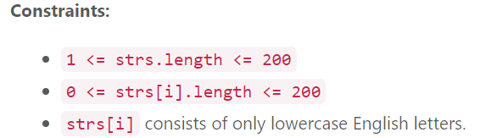
Longest Common Prefix
Write a function to find the longest common prefix string amongst an array of strings. If there is no common prefix, return an empty string "".
Example 1:
Input: strs = ["flower","flow","flight"]
Output: "fl“
Example 2:
Input: strs = ["dog","racecar","car"]
Output: ""
Explanation: There is no common prefix among the input strings.

Slide 13


What is text searching?
• Text searching is a technique used to find within a text t a match for a pattern p, where text, pattern, and match can be interpreted in different ways.

Slide 14

Text Searching Examples
• Search for a customer's name in a customers list • Search for a word or phrase in a document • Search for approximate file name in a directory • Search for a phone number in a form

Slide 15
Simple Text Searching (Brute Force Algorithm)
Section 1

Slide 16
Content
▪ The idea of algorithm ▪ Implementation ▪ Pros and cons

Slide 17
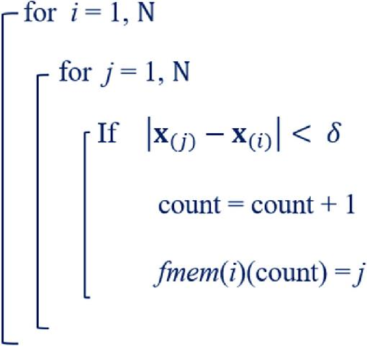
1. The idea of algorithm
• The simplest to implement • Compare t against p letter by letter until match or end of text is found.

Slide 18
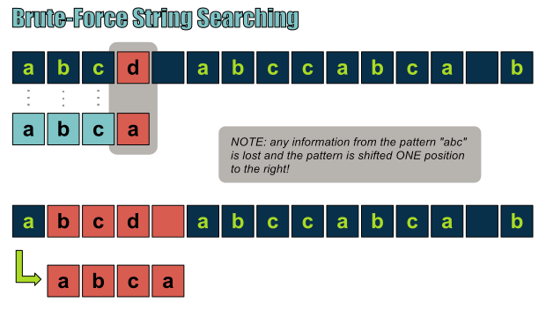
Brute-Force String Searching

Slide 19
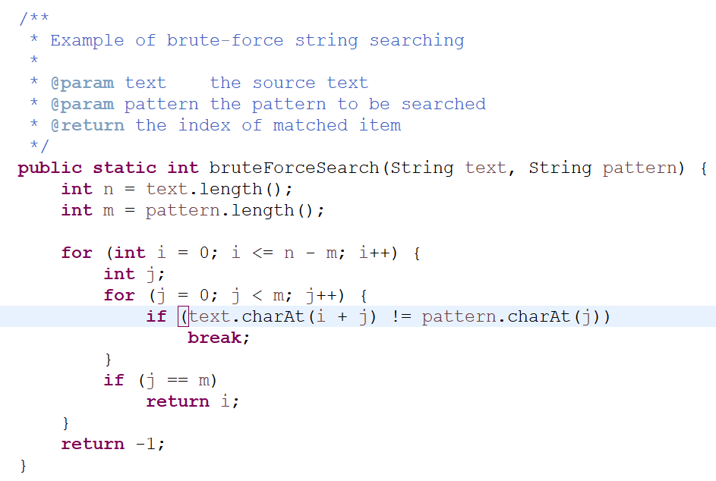
Brute-Force Search - Example

Slide 20


Pros & Cons of Brute-Force Search
• Very easy to implement • This algorithm runs in O(m*n) since for each character in t we need to start matching with p until mismatch or until end of text. • For large documents and length of the pattern, this can be really slow.

Slide 21
Rabin Karp Algorithm
Section 2

Slide 22
Content
▪ Overview ▪ The idea of algorithm ▪ Implementation ▪ Pros and Cons ▪ Rabin-Karp algorithm applications

Slide 23
Rabin-Karp Algorithm
• The Rabin-Karp algorithm is a string searching algorithm that utilizes hashing to compare the pattern with substrings of the text efficiently. • Hash value is used to efficiently check for potential matches between a pattern and substrings of a larger text.

Slide 24
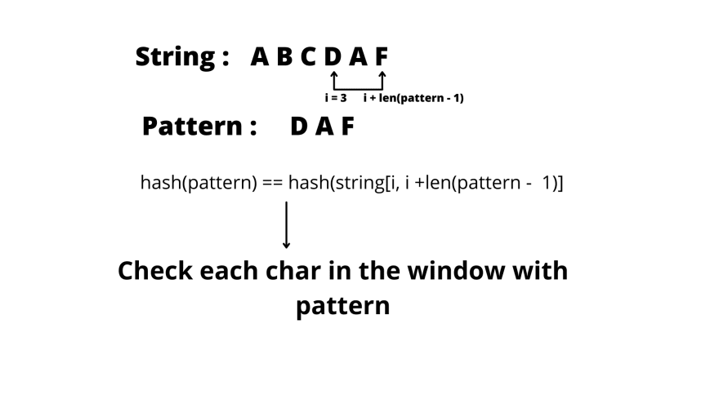
Rabin-Karp Algorithm

Slide 25
The idea of algorithm
• Create a fingerprint for every substring in t that has the same length as p. • Compare the letters only when the fingerprint match. • We need to find fingerprint function that fulfills ✓Maps strings with length m to q values ✓Distribute the string evenly among the q values ✓Easy to compute

Slide 26
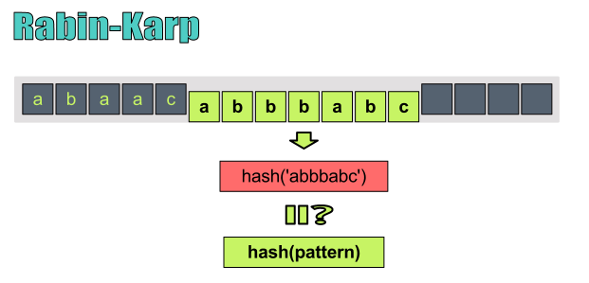
The idea of algorithm

Slide 27
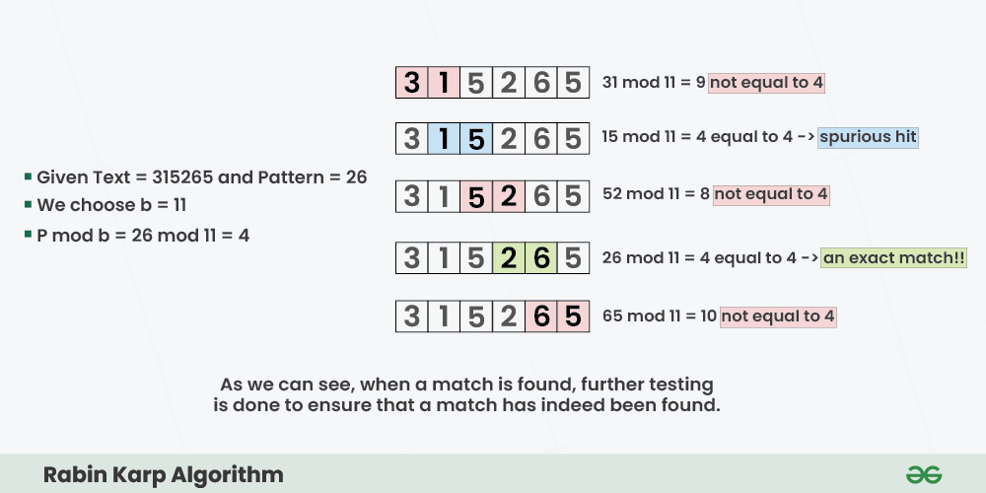
Rabin Karp Algorithm - Example

Slide 28
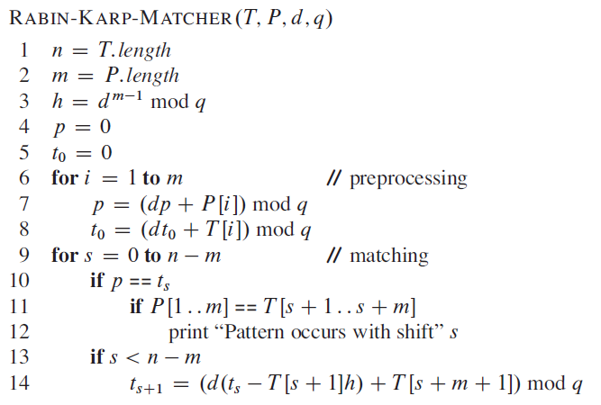
Rabin Karp Algorithm

Slide 29
Rabin Karp Complexity
• The average case and best case complexity of Rabin-Karp algorithm is O(m + n). • The worst case complexity is O(mn).

Slide 30
Pros & Cons
• Advantages ✓Efficiency ✓Multiple Pattern Processing ✓Hash-based comparison • Disadvantages ✓Hash collisions ✓Space complexity : requires extra space to store hash values for patterns and text substrings. ✓Slow in the worst case: all characters in the text and figure are the same.

Slide 31
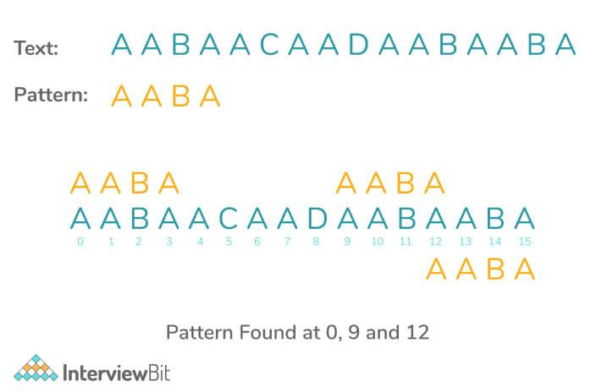
Rabin-Karp Algorithm Applications
• Pattern matching • Searching string in a bigger text

Slide 32
Knuth-Morris-Pratt (KMP) Algorithm
Section 3

Slide 33
Content
▪ Overview ▪ The idea of algorithm ▪ Implementation ▪ Pros and Cons ▪ KMP applications

Slide 34
Knuth Morris Pratt
• Knuth Morris Pratt (KMP) is an algorithm, which checks the characters from left to right. • When a mismatch occurs, it uses a preprocessed table called "Prefix Table" to skip character.rs comparison while matching

Slide 35
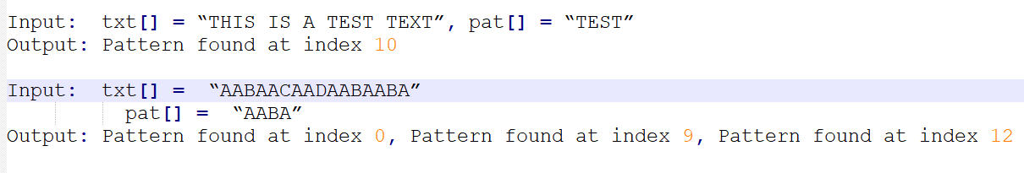
The idea of KMP

Slide 36
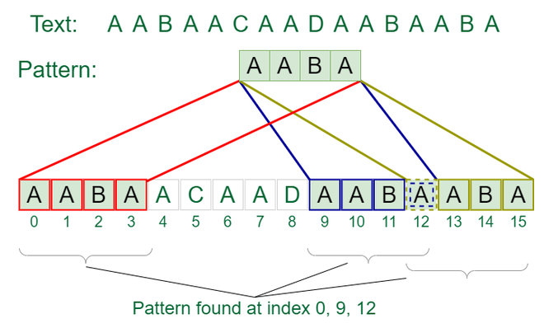
The idea of KMP

Slide 37
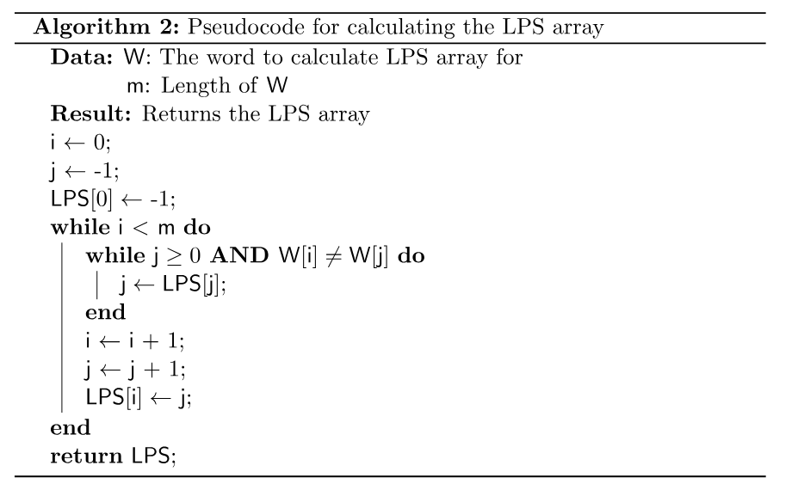
Calculate Longest Proper Prefix

Slide 38
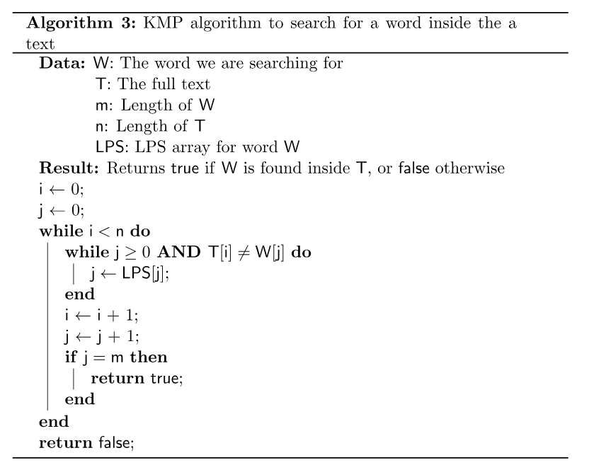
KMP Search

Slide 39
Complexity
• The algorithm runs in O(n+m) time. • O(m) for computing function f. • O(n) for searching p

Slide 40
Pros and Cons
• Advantages ✓Very fast as compared to any other exact string matching algorithm. ✓No worse case or accidental inputs exist here • Disadvantages ✓Quite complex to understand

Slide 41



Applications of the KMP Algorithm
• Checking for Plagiarism in documents • Spelling checkers • Search engines • Searching content in large databases

Slide 44
<CONTENT #1>
Section 1

Slide 45
THANK YOU!

